Slide 1


BUSINESS ETIQUETTE - 5

Slide 2
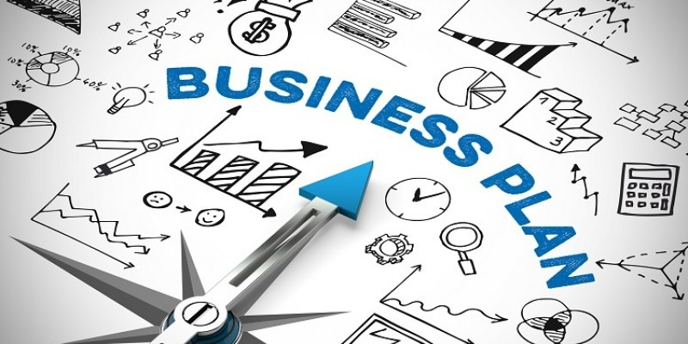
PLANNING, PROGRESS CHECK, TYPES OF PLANNING

Slide 3
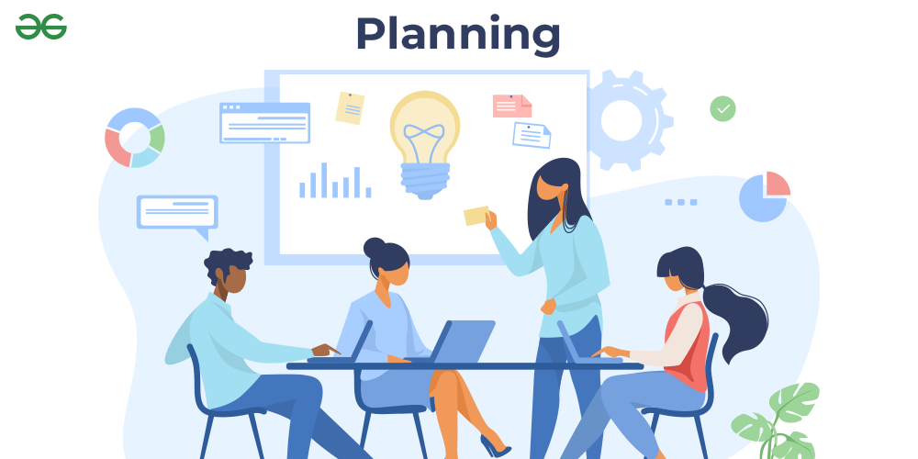
Preface
Planning in business etiquette refers to the proactive steps taken to ensure that professional interactions, communications, and behaviors align with accepted standards and expectations within a business context.
Proper planning ensures that business etiquette is consistently maintained, which in turn promotes professionalism, respect, and successful business relationships.

Slide 4
Importance of Planning in Business Etiquette
Consistency: Planning ensures that you consistently display proper etiquette across all business interactions.
Reputation Management: By planning ahead, you reduce the risk of making etiquette mistakes that could damage your professional reputation.
Building Relationships: Thoughtful planning shows respect for others’ time, preferences, and cultural norms, which strengthens business relationships.

Slide 5
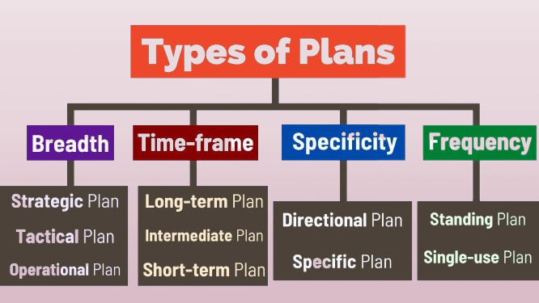

Slide 6

Planning Based on Breadth

Slide 7
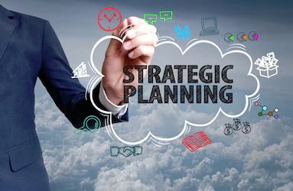
Strategic Planning
This is broad, high-level planning that focuses on the overall direction of the organization.
Long-term in nature, often spanning 3-5 years or more.
Involves defining the organization’s mission, vision, values, and overall goals.
Decisions made at this level impact the entire organization.
Examples: Market expansion strategies, mergers and acquisitions, entering new industries.

Slide 8
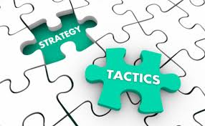
Tactical Planning
Tactical planning breaks down strategic plans into specific, actionable steps. It is narrower in scope and focused on specific business units or departments.
Mid-term focus, usually ranging from 1-3 years.
Supports strategic objectives by outlining detailed actions for various departments.
Involves resource allocation, operational plans, and department-level strategies.
Examples: Developing a marketing campaign, setting sales targets for a new product line.

Slide 9

Operational Planning
Operational planning focuses on the day-to-day activities required to run the organization. It is the most detailed and narrow type of planning.
Short-term focus, typically covering a few months to a year.
Deals with specific tasks, routines, and procedures.
Ensures that employees understand their daily tasks and responsibilities.
Examples: Scheduling staff shifts, setting daily production goals, managing inventory.

Slide 10

Planning Based on Time Frame

Slide 11
Short-Term Planning
Planning that focuses on immediate needs and results, typically covering a few days to a year.
Involves planning for specific tasks or objectives that need to be accomplished quickly.
Often involves operational and tactical plans.
Requires flexibility to adapt to changing circumstances.
Examples: Monthly budget planning, responding to a sudden market change, or planning a marketing campaign launch.

Slide 12
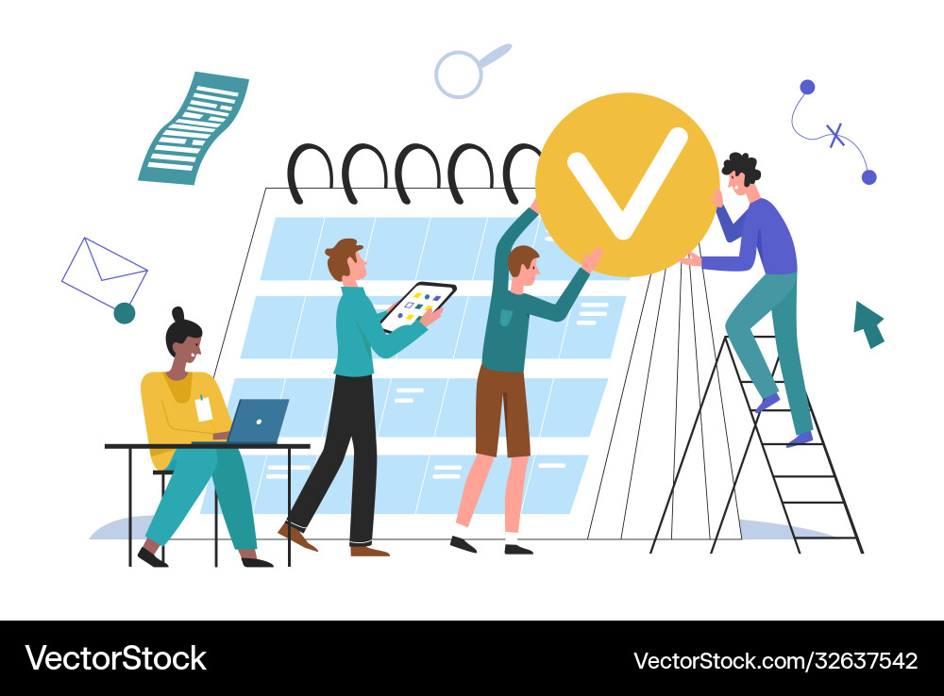
Medium-Term Planning
Planning that spans from 1 to 3 years and bridges the gap between short-term and long-term goals.
Focuses on achieving objectives that contribute to the organization’s strategic goals.
Includes elements of both tactical and strategic planning.
Balances the need for flexibility with a longer-term perspective.
Examples: Developing a new product, entering a new geographic market, or implementing a company-wide technology upgrade.

Slide 13
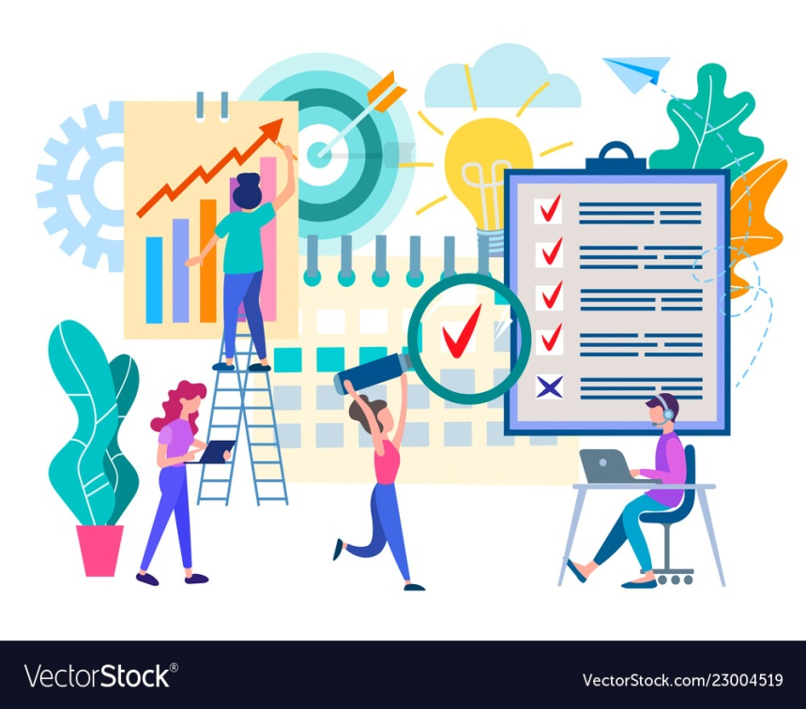
Long-Term Planning
Planning that covers a period beyond 3 years and is focused on achieving the organization’s vision and overarching goals.
Involves strategic decision-making.
Considers the external environment, industry trends, and future opportunities.
Typically less detailed but sets the direction for shorter-term plans.
Examples: Setting a company’s 10-year growth strategy, planning for sustainability initiatives, or positioning the company for technological disruption.

Slide 14
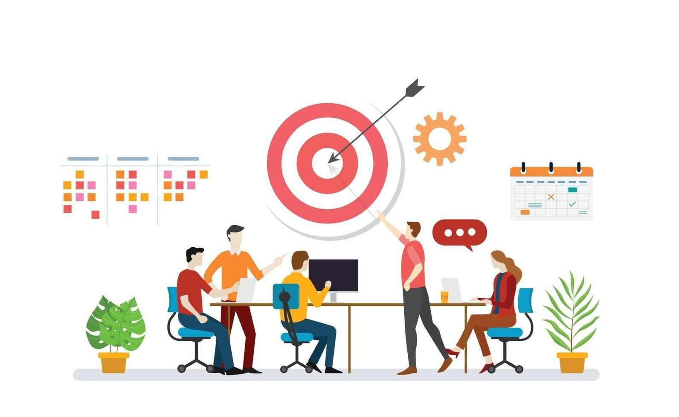
Planning Based on Specificity

Slide 15
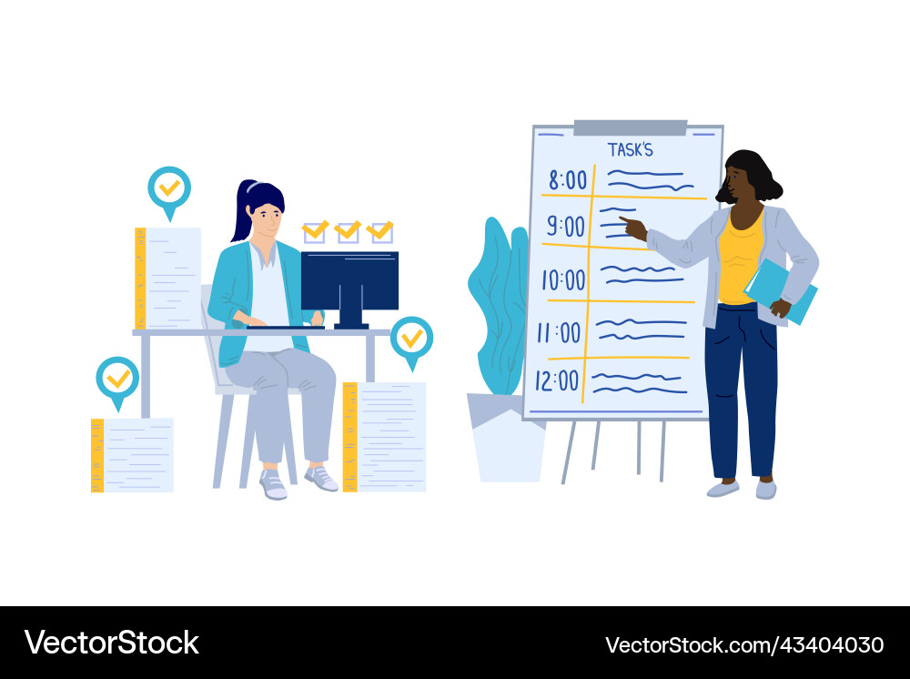
Specific Planning
Planning that involves clear, detailed, and well-defined objectives, actions, and steps.
Plans have measurable outcomes and concrete deadlines.
Focuses on particular tasks or processes within the organization.
Reduces ambiguity and ensures everyone knows what is expected.
Examples: Launching a new product, creating a step-by-step project plan, or setting up a detailed employee training program.

Slide 16
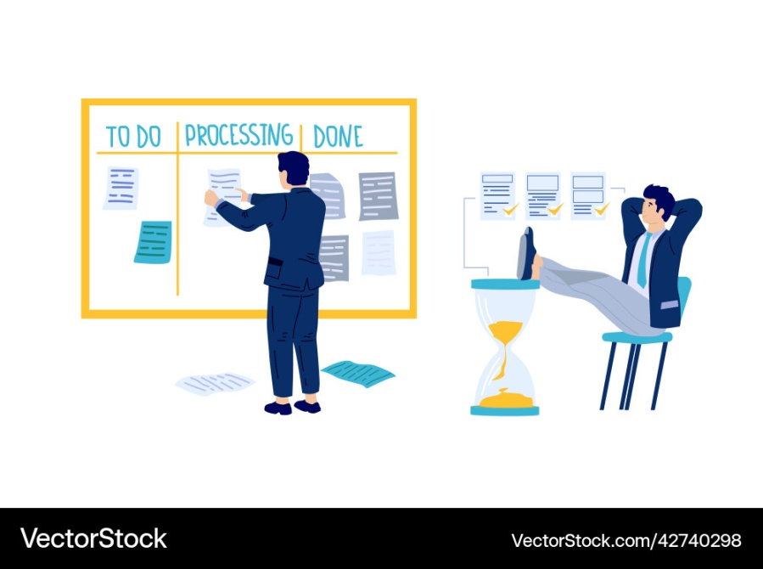
Directional Planning
Planning that provides general guidelines and a broad direction for the organization, but leaves room for flexibility and interpretation.
Less detailed and more flexible than specific planning.
Focuses on establishing an overall path or framework rather than fixed steps.
Adaptable to changing circumstances and emerging opportunities.
Examples: Setting a broad strategic direction for innovation, establishing guidelines for entering international markets, or creating a vision statement for company culture.

Slide 17
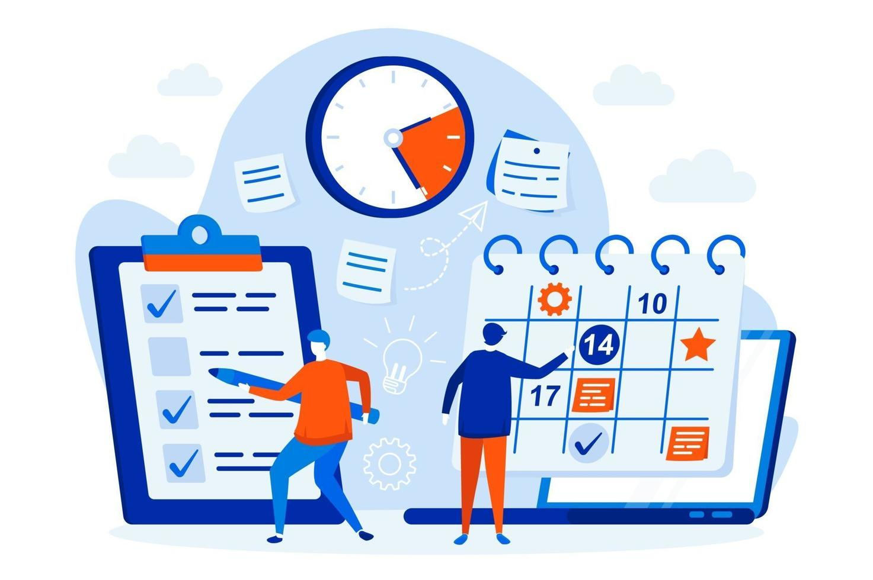
Planning Based on Frequency

Slide 18
Single-Use Planning
Planning that is designed to address a unique or one-time event or project.
Plans are not repeated once the goal is achieved.
Typically involves detailed, specific planning with a defined beginning and end.
Focuses on achieving a specific objective or resolving a particular issue.
Examples: Developing a project plan for a new office relocation, organizing a company-wide event, or implementing a new software system.

Slide 19
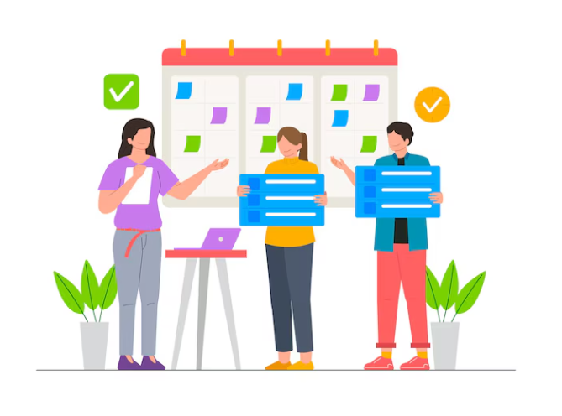
Standing Planning
Planning that is ongoing and used repeatedly to address recurring activities or issues.
Focuses on routine tasks and standard procedures.
Guides day-to-day operations and ensures consistency.
Can include policies, procedures, and rules that remain in place over time.
Examples: Establishing an annual budgeting process, developing standard operating procedures (SOPs), or creating a customer service protocol.

Slide 20
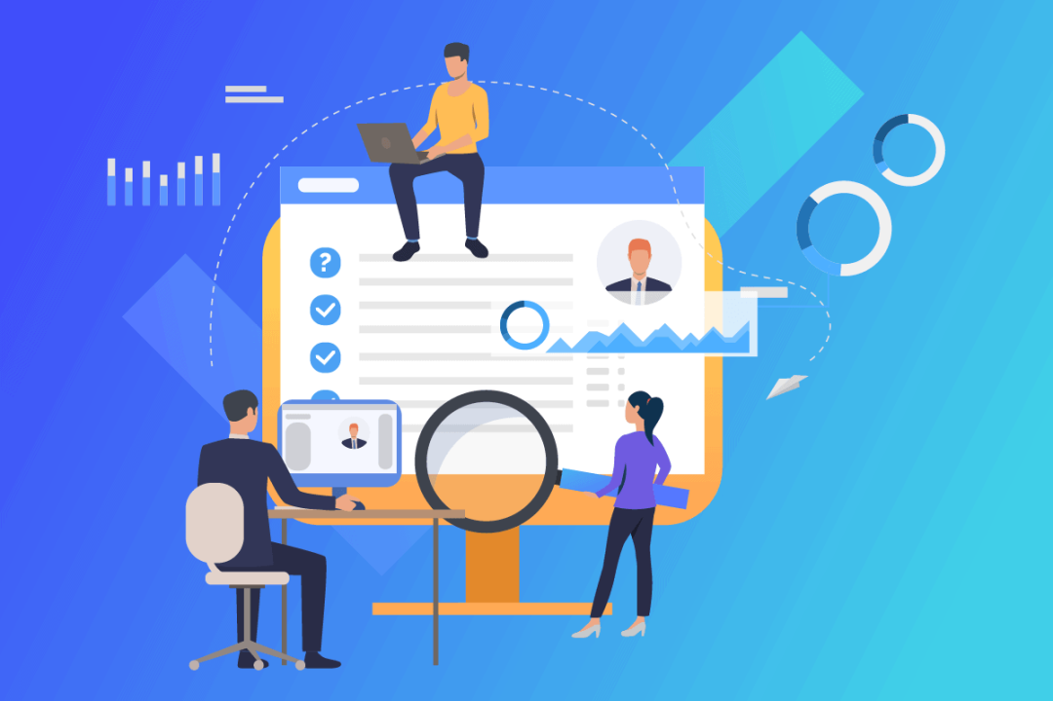
PROGRESS CHECK IN BUSINESS

Slide 21
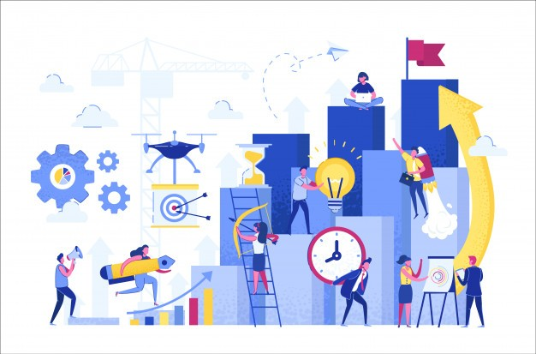
Progress check in business etiquette refers to the ongoing assessment and monitoring of how well professional behavior, communication, and etiquette standards are being upheld within a business setting. It ensures that business interactions align with established norms and expectations, contributing to effective relationships, a positive reputation, and overall business success.

Slide 22
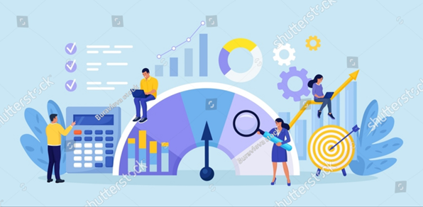
Methods of Conducting Progress Checks
Self-Assessment
Peer Feedback
Managerial Reviews
Client or Partner Feedback

Slide 23
a. Self-Assessment
Individuals reflect on their own behavior and communication to assess whether they are adhering to business etiquette norms.
Regularly evaluate how professional, polite, and respectful their interactions have been.
Encourages personal accountability and self-improvement.
b. Peer Feedback
Colleagues provide constructive feedback to one another regarding their adherence to business etiquette.
Regular feedback sessions, either formally or informally, where peers discuss etiquette-related behavior.
Use of structured feedback tools, such as 360-degree feedback surveys, that include etiquette components.
Provides different perspectives and encourages team cohesion through mutual respect.

Slide 24
c.Managerial Reviews
Managers monitor and evaluate their team’s etiquette and professionalism through regular reviews and observations.
Provide regular feedback to team members on their professional conduct and communication skills.
Ensures that etiquette is recognized as a key aspect of job performance and provides a formal mechanism for accountability.
d.Client or Partner Feedback
Businesses solicit feedback from clients, partners, or other external stakeholders on the professionalism and etiquette of their interactions.
Use customer satisfaction surveys or follow-up calls that include questions on communication and professionalism.
Provides valuable insights from those outside the organization, helping to align

Slide 25
Benefits of Regular Progress Checks
Enhanced Professionalism: Regular progress checks help maintain high standards of professionalism across the organization.
Improved Relationships: Consistently practicing good business etiquette fosters stronger relationships with clients, partners, and colleagues.
Positive Reputation: A focus on etiquette contributes to a positive reputation, both internally and externally.
Increased Accountability: Progress checks hold individuals accountable for their behavior and encourage personal responsibility.

Slide 26
QUESTION 1
When should a business typically engage in succession planning in the context of business etiquette?
Only when a company is facing financial difficulties
After an employee has retired or left the organization
During the initial stages of strategic planning
Continuously, as part of long-term organizational development
Notes:
ANS:4

Slide 27
QUESTION 2
Which type of planning in business etiquette involves anticipating potential conflicts and developing strategies to address them?
Contingency planning
Operational planning
Strategic planning
Tactical planning
Notes:
ANS:4

Slide 28
QUESTION 3
What is strategic planning in the context of business etiquette, and how does it differ from operational planning?
Strategic planning involves long-term goals and overall direction, while operational planning focuses on day-to-day tasks and activities.
Strategic planning is exclusively related to financial aspects, whereas operational planning deals with interpersonal skills.
Strategic planning primarily addresses employee attire, while operational planning focuses on communication protocols.
There is no distinction between strategic and operational planning in business etiquette.
Notes:
ANS:1

Slide 29
QUESTION 4
What distinguishes contingency planning from other types of planning in business etiquette?
It focuses on emergency response and crisis management.
It revolves around long-term sustainability goals.
It deals with employee training programs exclusively.
It emphasizes workplace diversity initiatives.
Notes:
ANS:1

Slide 30
QUESTION 5
In business etiquette, what does tactical planning primarily involve?
A)Determining long-term organizational goals
B) Establishing overall corporate culture
C) Developing specific methods to achieve strategic objectives
D) Maintaining day-to-day operations efficiency
Notes:
ANS:3

Slide 31
QUESTION 6
Which planning approach in business etiquette involves analyzing current practices and identifying areas for improvement?
Continuous improvement planning
Crisis management planning
Succession planning
Interpersonal planning
Notes:
ANS:1

Slide 32
QUESTION 7
In business etiquette, what does continuous improvement planning primarily focus on?
Adhering to legal and regulatory requirements
Enhancing communication and collaboration among employees
Developing strategies for long-term financial growth
Implementing technology upgrades and innovations
Notes:
ANS:2

Slide 33
QUESTION 8
What is the primary objective of crisis management planning in business etiquette?
To ensure appropriate dress code adherence
To foster a positive work environment
To mitigate potential damage to reputation and operations
To organize company events and social gatherings
Notes:
ANS:3

Slide 34
THANK YOU

